Slide 1
Information for
Robins’ Parents
Notes:
Welcome to your first Class Meeting
Robins Class is the next stage in your child’s learning journey.
It’s a time of lots of new experiences.
It’s a busy year for them and us.
1

Slide 2
Classes at Hope Brook
There are currently 5 classes at Hope Brook:
Kestrels’ Class – Year 6
Kingfishers’ Class – Year 4 + 5
Wagtails’ Class – Year 3 + 4
Woodpeckers’ Class – Year 1 + 2
Robins’ Class – Reception + Year 1

Slide 3
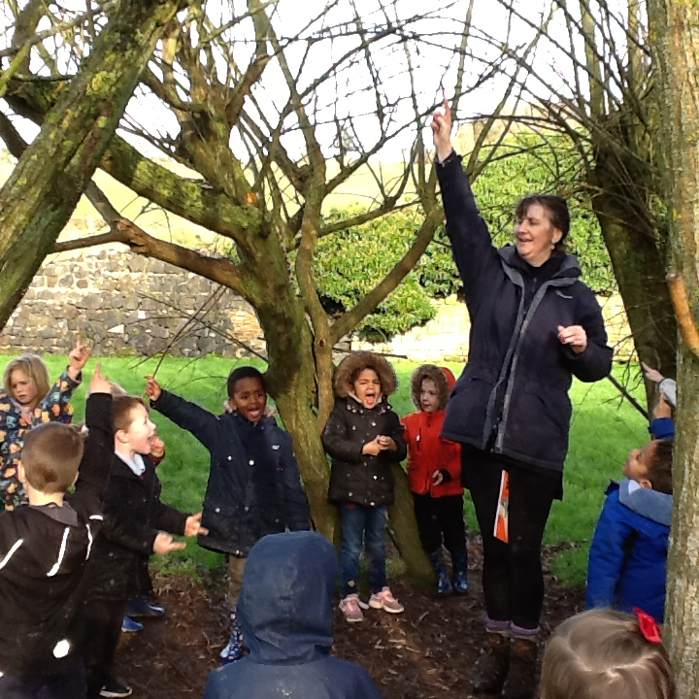
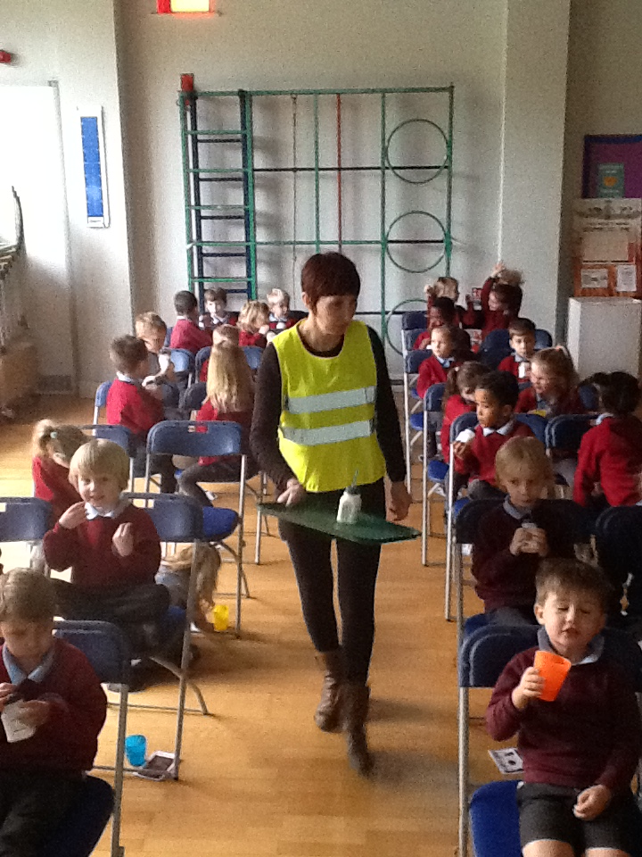
Meet Robins’ Staff!
Ms Rowe - Teacher
Mrs Davis – Teaching Assistant
Mrs Stanton – Teacher - Tuesday afternoons and alternate Tuesday mornings from October

Slide 4
Robins’ Class
As a Reception and Year One Class, children experience a curriculum relevant to their stage of development:
Early Years Foundation Stage Curriculum (Reception/Year Ones)
National Curriculum (Year Ones)
We have high expectations in terms of showing respect to one another and attitudes to learning.

Slide 5
All children are offered opportunities to develop key learning ‘tools’ to equip them for life long learning
Resilience - To maintain the desire to see a task through to the end.
Cooperation - To work with others, listen, reflect, respond and negotiate.
Competence - To believe in their ability to succeed.
Concentration - To maintain their focus on a task.
Independence -To understand they need to take ownership of what they do and say.
It is easy to think doing everything for our children makes us caring adults but the reality is
doing everything for our children inhibits their development in each of the areas of above.
Notes:
.
5

Slide 6
A typical morning during Autumn Term 1
8.45am Reception – Free play
Year 1s - Early Morning Task
9am Year 1 - Phonics
Reception - Phonics and a fine motor activity
9.30am Year 1 - Reading Groups and follow up activities
Reception – Reading Groups and Free Play
10.15am Toilet Time
10.20am 5 minute run
10.30am Collective Worship - via Zoom
10.40am Snack Time
10.50am Play Time
11.05am Maths Focus
12.05pm Lunch Time
The structure of the day evolves during the year.

Slide 7
A typical afternoon during Autumn Term 2
1pm Calm Down Time
Year 1s – Handwriting
Reception – Fine motor activity evolving into Handwriting
1.25pm Whole Class Topic Focus
Group task or activity with an adult
Free Play
2.50pm English Focus (Tricky Words or Story Time)
3.15pm Home Time

Slide 8
Drink and Snack Time
During the morning children sit as a whole class to drink their milk or water and eat a piece of fruit or vegetable.
If you would like your child to have milk, then please register. It’s free until they are 5 years old. Generally it takes a week or two to set up.
https://www.hopebrook.co.uk/website/snack_and_drink_time/490940

Slide 9
Active Learning Afternoons
Active Learning Afternoons will be on a Wednesday this term.
There will be two groups:
Reception with Ms Rowe
Year Ones and Twos with Mrs Blackman
This term we are suggesting your child comes into school wearing their Active Learning Clothes (outdoor shoes in a named carrier bag).
Suitable clothes, are those you don’t mind getting covered in mud:
leggings or trousers
t-shirt
jumper/cardigan/hoody
coat or all in one waterproof
spare pair of socks is often useful

Slide 10
Homework
Reception
Each week your child will have one on- line book to share/read at home.
Each week there will be a short video(s), for children and parents to use to practice:
The week’s focus sounds
The week’s focus tricky words
Year One
Each week your child will have one on- line book to share/read at home.
Each week there will be information re this week’s sounds and tricky words on E- Schools
Occasional homework sent via E-Schools

Slide 11
A look at English and Maths in Robins’ Class

Slide 12
Autumn Term 1 - English
Reception
Year One
Learning Phase 2 sounds
Blending and segmenting words such as cat and dog
Reading Phase 2 tricky words
Reading pictures in story books
Hearing rhyming words
Enjoying poems
Fine motor skills evolving into starting to develop accurate letter formation (lower case)
Revising Phase 2-3 sounds
Revising Phase 2-3 tricky words.
Independent reading
Enjoying poems
Writing sentences
Spelling rules:
Reading ing/ed words (jumped)
Reading s/es words
Handwriting
Lower case letter (orientation/size)
Capital letters

Slide 13
Maths - counting
This term we devote a lot of time to securing the ability to count accurately and consistently.
The more experiences, the better! Look out for everyday opportunities:
Count the stairs to bed
Count the spoonfuls of flour when making cakes
Count the cars you see on the way to school
Count the number of birds in the garden
Notes:
13

Slide 14
Maths: from counting to word challenges!
Counting one for one
Reading numerals (1-5, 1-10, 1-20 ….)
More/less
Counting altogether ( + = 5)
Adding on (6+ = 9)
Number questions (6+3=9)
Word challenges (Jack bought 2 cars. One car cost 2p. The other 3p. How much did he spend.)
Notes:
14

Slide 15
Communication

Slide 16
Communication between Home and School during the current restrictions.
Phone or email to arrange a conversation or meeting
School Website
E-Schools
Tapestry for Reception

Slide 17
The School Website and E Schools
Robins Class has it’s own area on the school website for information and photos. There is usually something new added each week.
https://www.hopebrook.co.uk/website/robins/312877
Useful weekly information will be posted on Friday each week on the school calendar, so it’s worth taking a look over the weekend each week.
https://www.hopebrook.co.uk/website/calendar/309901
Homework sent via E Schools
Please look out for information sent via admin to set this up.

Slide 18
Tapestry for Reception
An easy-to-use and secure online Journal helping families and staff share children’s experiences.
For more information: https://tapestry.info/parents-carers.html
Take a look at the guidance film added on your Tapestry area, showing how you can add your own observations.

Slide 19
Various

Slide 20
Children play in our Outside Play Area and in the Classroom, throughout the day. The outside door is often left open or regularly opened by children. A vest is a great layer to wear under their school uniform.
If your child is unwell, please phone and let school know they will not be in school.
Please label all items belonging to your child.
Please ensure all items of clothing are clearly named.

Slide 21
Thank you for taking the time to read all this information. If anything is unclear, please ask.
From Ms Rowe and Mrs Davis

