Slide 1
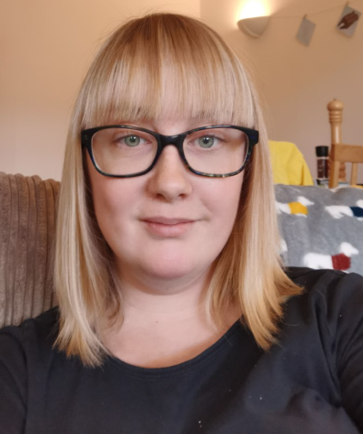
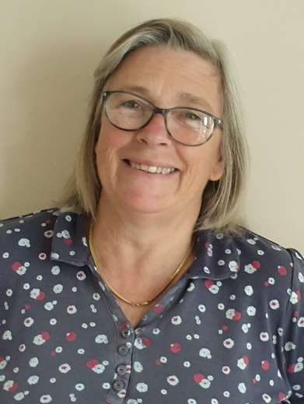
Wagtails Class
Welcome to Wagtails Class. This year it is a mixed year 3 and 4 class.
The staff based in here are myself (Miss Kay – Class Teacher), Mrs Harrington (Class TA), Miss Roberts (1:1 support) and Mrs Hodges (1:1 Support).

Slide 2
Being ready to learn everyday
Arrive on time for school for 8:45 – inform the office of any lateness or absence.
PE kit (to be kept in school until the end of term) – indoor and outdoor kit, both labelled.
Each day:
Water bottle (not kept inside their lunch box)
Jumper and waterproof/coat
Healthy Snack (we don’t always have fruit provided)
No bags, pencil cases or stationery from home to be brought in.

Slide 3
Children’s responsibilities
We set high expectations for children coming into KS2 to build up their independence. We initially will support and remind them to do these things but then we expect that they will self manage these responsibilities:
Putting lunchboxes on the trolley.
Keeping track of their pencils, rulers, pens and rubbers.
Bringing a jumper and an appropriate jacket.
Carrying their own things in and out of school.

Slide 4
Days to remember:
PE is on Wednesday and Friday
(All PE will be outside, if this is not possible we will exercise in the classroom).
Spelling tests on Friday – results will not always be given before Monday.
Times tables test will be done on a Monday and Friday.
Homework will go out on a Friday and be due in on Thursdays.
Outdoor Learning Days are not set the same every week in KS2 so we will send out a message if and when it is needed the week before.

Slide 5
Daily Routine
Children come in at 8:45 and our first lesson starts at 9:00. In Wagtails class, we keep the children’s snacks in their drawers and lunchboxes are placed on the trolley outside the classroom.
The children will use Times Tables Rock Stars, Maths Frame or complete a quick challenge on entry every morning.
If your child is having dinners provided by the school, this is now booked online.
Assemblies are before snack and break. These will be done over Zoom or in our individual classrooms. Celebration assembly will continue to be on Fridays.

Slide 6
Daily Routine
Snacks before break should be healthy and crisps and chocolate should be avoided.
Maths is usually our first lesson of the day, followed by Guided Reading, Spellings/Phonics and English before lunch.
In the afternoon, we have a mixture of Topic, Art, French, PE, Computing, RE, Science and Music.
At the end of the day, we will read from a class story book before heading out of class.
At 3:15, the children will be picked up from the Recreation ground.

Slide 7
Rewards
In Wagtails the children each have a Class Dojo character, they will then receive points for things like:
Good effort in their work
Reading 4 or more times a week at home
Moving onto a new times table
Listening well
Participating in class discussions
Not giving up on challenging work
Being kind to others
Helping others
Good behaviour in class and around school
Showing respect for others
Children will also receive ‘Good Work’ certificates for any of the above or significant achievements in homework, challenges they are working to overcome and skills they have achieved.
When the children have recieved 5 certificates, they are able to keep ‘Good Work Cup’ a week. If they earn this cup 5 times, they will get to keep the cup.

Slide 8
Curriculum
As we return to school after a very different Summer term to normal, we understand that some children will need extra support to get back into school, meet the expected standards and develop their social skills again so we will be working on all of these things.
Our topic for Autumn term 1 is The Roman Invaders.
Our Topic web is on the Wagtails’ class page, here you can see what we are doing in each subject.
Year 3 children will be starting French for the first time.
Please see the class page on the website for updates of what we are up to, along with photographs.
We will also complete a Daily Mile (weather dependent), desk dance or yoga every day.

Slide 9
Trips and Clubs
Usually we have a trip or visitor in each (or most) terms.
Due to the current Covid-19 situation, this is not going to be happening during the Autumn term. Hopefully this will change in the new year.
Year 3 and 4 usually go swimming during Autumn term, this is also currently unable to happen, but we will notify you when this changes.
There will be no after school clubs this term either.

Slide 10
Reading
Children should read at home everyday.
This does not have to always be with an adult, but an adult should have listened to them read about 4 times a week.
A Reading diary page to fill in will be sent out, via the homework page of the website, weekly from next week to be filled in and submitted online.
Children will not be bringing books home from School, but online books may sometimes be sent as homework.
When reading books from home, please read a mixture of fiction (varied authors) and non-fiction books.

Slide 11
Homework
Homework is now going to be set online – using the ‘Homework’ page of our website – the children will log in and complete it online.
We will be starting off with just Reading and Spellings before extending the homework online.
The first set of homework will go out on this Friday.
Spellings – Spellings will go onto the ‘Homework’ page on our website on Fridays. There will be an area for the children to type their spellings in sentences into to submit.
The children will sit a National Times Tables test in Year 4 during June. This will consist of 25 questions, for which they will only be given 6 seconds to answer each question. This means it is crucial that the children continue to use Times Table Rock Stars and Maths Frame Multiplication Check at home to practice. I would recommend they do this at least 3-4 times a week.

Slide 12
Homework (cont…)
Active Learn games will be available online next week.
We will also be using Lexia Reading online again this year, so some children will be able to log onto this for homework too.
If the children are finding any part of their homework difficult, please do not hesitate to email in.
If you have helped lots with the homework or parts of it – please leave a note detailing this in the homework.

Slide 13
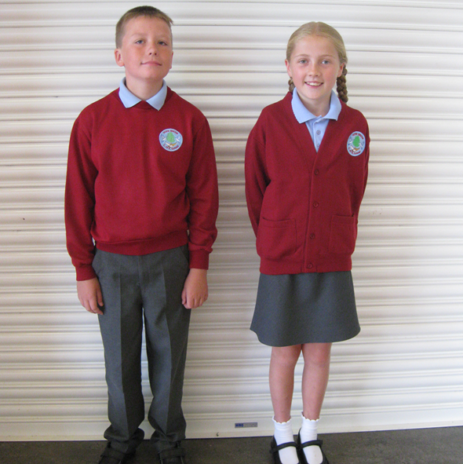
Uniform
If hair is tied back, plain black, blue or white hair bobbles.
Studs only to be worn; plain round studs.
If they wear lace up shoes, the children will need to be able to lace up their own shoes.
All uniform kit should be labelled.

Slide 14
PE kit
Hair tied back.
Earrings removed or covered with micro-pore tape.
Trainers – sports trainers (white non-marking soles)
All PE kit should be labelled.
They should keep an indoor and outdoor kit in school.

Slide 15
Assessments
As well as the weekly times tables and spelling tests, we have Maths and Reading assessments at the end of each half term.
This year we will be also be assessing gaps in knowledge from each child’s previous year, given the lockdown situation that we experienced.
At the end of the year, we use optional SATs in year 3 and 4 as a more formal end of year assessment.
Year 4 will sit a National Times Table test as mentioned previously.

Slide 16
Communicating
We will no longer see you on the classroom doors at drop off.
If you need to discuss anything with me, ask any questions or clarify more details, please contact admin@hopebrook.gloucs.sch.uk and I will be able to arrange a phone call, email back or arrange something else suitable.
At the current time, the office is not open to come in and leave a message personally.

